Slide 1
Whiteoak School Lagos
January 2021

Slide 2
Duly Registered and Approved By the Lagos State Ministry of Education

Slide 3
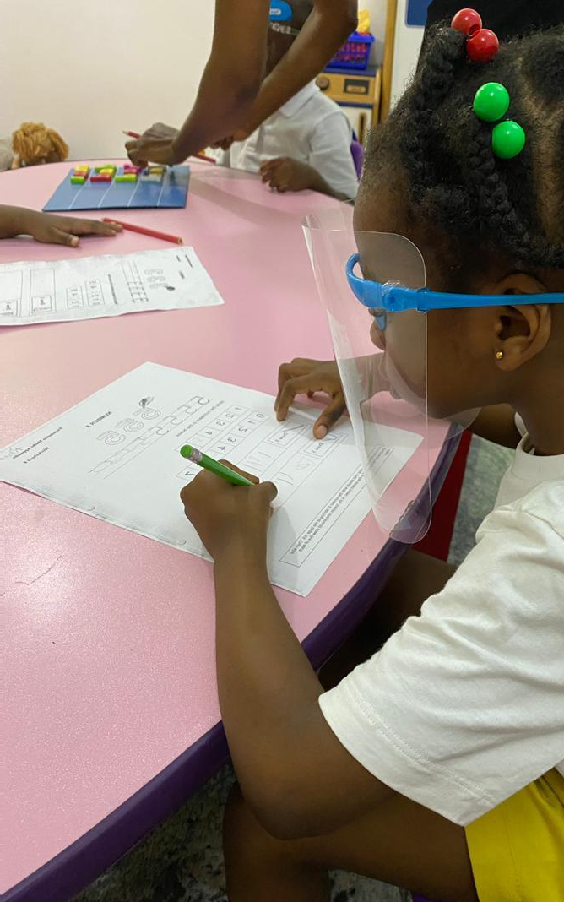
TABLE OF CONTENTS
Introduction
Company Overview
Product Overview
Conclusion

Slide 4
INTRODUCTION
At Whiteoak, we implement up to date strategies to engage and challenge staff to ensure we develop children's physical, intellectual, emotional and social well-being, thus guaranteeing the best outcomes, for the children placed in our care. Whiteoak has high expectation of her staff as their development directly affects outcomes, therefore routine up to date training is mandatory at Whiteoak. We provide a high-quality blended curriculum consisting of approved Nigerian & United Kingdom curriculum delivered in a world-class learning environment.
We have made available resources to make the learning experience as informative and pleasurable as possible such as an up to date Library, computer, Arts & Science lab, music room, playground and pool. We spare no cost to maintain a decent teacher to pupil ratio thereby ensuring every child has adequate attention. Our environment creates a balance for the children, beyond academics we ensure the children learn valuable life skills and are happy and trained to have respect for the individual.

Slide 5
Company Overview
Our Vision, Mission and Offerings
Vision:
To be the number one provider of an excellent and world-class
education.
Mission:
To develop students who are creative thinkers and have enquiring minds. To develop independent, innovative, knowledgeable children with a vision for a better tomorrow.
Our Offering:
We build foundations of excellence in our children, the school was established in 2009 and we have a ten-year record of producing well rounded children who have moved on and achieved educational feats.
We implement up to date strategies to engage and challenge staff to ensure we develop children's physical, intellectual, pastorial, emotional and social well-being, thus guarteeing that the best outcomes, for the children placed in our care. White Oak has high expectation of her staff as their development directly affects outcomes, therefore routine up to date training is mandatory at Whiteoak. We provide a high-quality blended curriculum consisting of approved Nigerian & United kingdom curriculum delivered in a world-class learning environment.
We have made available resources to make the learning experince as experiental and pleasurable as possible such as an up to date Library, computer, Arts & Science lab, music room, play ground and pool. We spare no cost to maintain a decent.

Slide 6
teacher to pupil ratio thereby ensuring every child has adequate attention.
Our enviroment creates a balance for the children, beyound academics we ensure the children learn valuable life skills and are happy and trained to have respect for the individual.
Whiteoak runs a program we call ‘Lead Path Program’ through this programme we have entered partnerships with institutions in the United Kingdom to assist our graduating students into colleges and secondary schools in the United Kingdom at the discreation of the parents.
While attending Whiteoak children will become successful learners who have enquiring minds, think for themselves, reason, question and evaluate. To achieve this, we follow the Early Years Foundation Stage through Primary school;
This approach to learning has been approved in the UK and indeed worldwide following years of extensive research by Early Years professionals.

Slide 7
Management team
Mrs Teresa Oniru BA(Hon) Dip. Child Care and Education. Managing Director/Director of curriculum
She has worked in education for over 20 years both in the UK and Nigeria. She has a BA in Early Years' Education and a Diploma in Child Care and Education. She is first aid trained and regularly attends training courses in Nigeria and abroad in order to stay abreast of changes to the UK national curriculum as well as other educational strategic development across nursery, foundation stage and key stages one and two
Ms Krishna Dave
BA in Economics – Commerce, Certified Riverside teacher, DECE. (Diploma in Early childhood Education).
Ms Krishna is the Head of School and she joined the school from March 2021. She has over 20 years’ experience in the Educational Sector. She completed her education from Mumbai and is from Gujarat region in India and is married.
She has developed skills in Differentiated Instructions, Multiple Intelligence, Classroom Management, basic Mathematics and Teaching for Understanding.
She has worked in several organizations in different capacities; Class teacher at TGS - Wadi (Prep Unit), Aditya Birla Public School (Veraval), Counselor and Assistant Mgr. with Sukh Sagor Institute – Mumbai.
She is very passionate and focused about her work and understands the importance of building a community. She empowers teachers and cultivates leadership skills in them. She works towards the vision of the schools and plans effectively to achieve it.
She believes that each child is different and has his / her own way to learn and show their understanding. Teachers need to be the facilitators who facilitate the child’s learning journey.

Slide 8
Mrs Yemisi Arutere (B(Ed) in Guidance and Counselling, M(Ed) in Educational Psychology and M(Ed) in Educational Administration Deputy Head of School
Yemisi Arutere is the assistant head of school and head of Primary at Whiteoak School Lagos. She previously held the position of Year 1 lead teacher. An efficient, innovative and creative teacher
An innovative visionary who prides herself in implementing up to date strategies in order to engage, challenge and motivate children and staff.
She is an efficient, innovative and creative teacher who thrives on producing the very best outcomes for students and clients alike. Excellent people skills, able to work as part of a team as well as on own initiative. Personal interest in education, supporting educational establishments, sharing skills and ideas; mentoring individuals and training staff to meet set standards

Slide 9
Non - Executive Directors
Mrs. Cathleen Aderounmu
Has always nurtured a passion for early years education. She undertook her Primary and Secondary education in Nigeria after which she proceeded to the United Kingdom.
Furthermore, following her study of Childhood Development in the USA, she returned to Nigeria and went on to work in leading educational institutions in Lagos state. As early childhood is a significant time in a child’s life; in which personality and intellectual abilities are developed; she is a firm believer in using all the tools required to allow a child to fulfill potential; such as creating a positive and peaceful environment. As a mother herself, she is driven and keen in her resolve to see the social, emotional, cognitive and physical development of children which will stand them in good stead towards achieving their life's goals. She is committed to working alongside parents in ensuring the best level of teaching and support is given to their children as well as providing a happy and rewarding experience for the pupils of White Oak school.
Mrs. Quineth Nwanze
Mrs Nwanze is a financial professional with two decades of working experience spanning across media, financial structuring, commercial banking and asset management. She started her working career in 2000, as a marketing and media consultant before moving into finance in 2002 as an
asset / portfolio manager with credit swift Limited in Ikoyi Lagos. She then moved to commercial banking where she gathered
experience in the commercial banking sector while working in First City Monument Bank Plc.
Mrs Nwanze holds a Bsc. in Economics from ESUT and a Masters Degree from University Of Leicester England. She is a fellow of the Institute of Certified Sales Professional (ICSP). She has

Slide 10
attended several courses and programs including the ‘Senior Management Programme’ SMP at Lagos Business School.
She is a mother of two and is dedicated to the development of children.
As a Board Director overseeing Finance & Media she will ensure the business side of the school remains healthy and the institution remains a going concern with sustained growth. She will also make sure the school becomes a known brand and projected positively in the public domain.

Slide 11
Product Overview
The Early Years Foundation Stage (EYFS)
This is the Curriculum for children from birth to 5. At Whiteoak school. This guides the teaching and learning in from Acorns all the way through to Pre-school.
The EYFS is made up of 4 themes: The Unique Child, Positive Relationships, The Enabling Environment and Learning and development. These themes are important as they all combine to ensure young children make good, strong progress in their
earliest years. This Stage in life is the most important as children’s minds and bodies grow and develop most from birth to age 4.
In Learning and Development there are 7 Areas of learning in which the curriculum is organised into. This is to ensure children make all round development in this important stage.

Slide 12
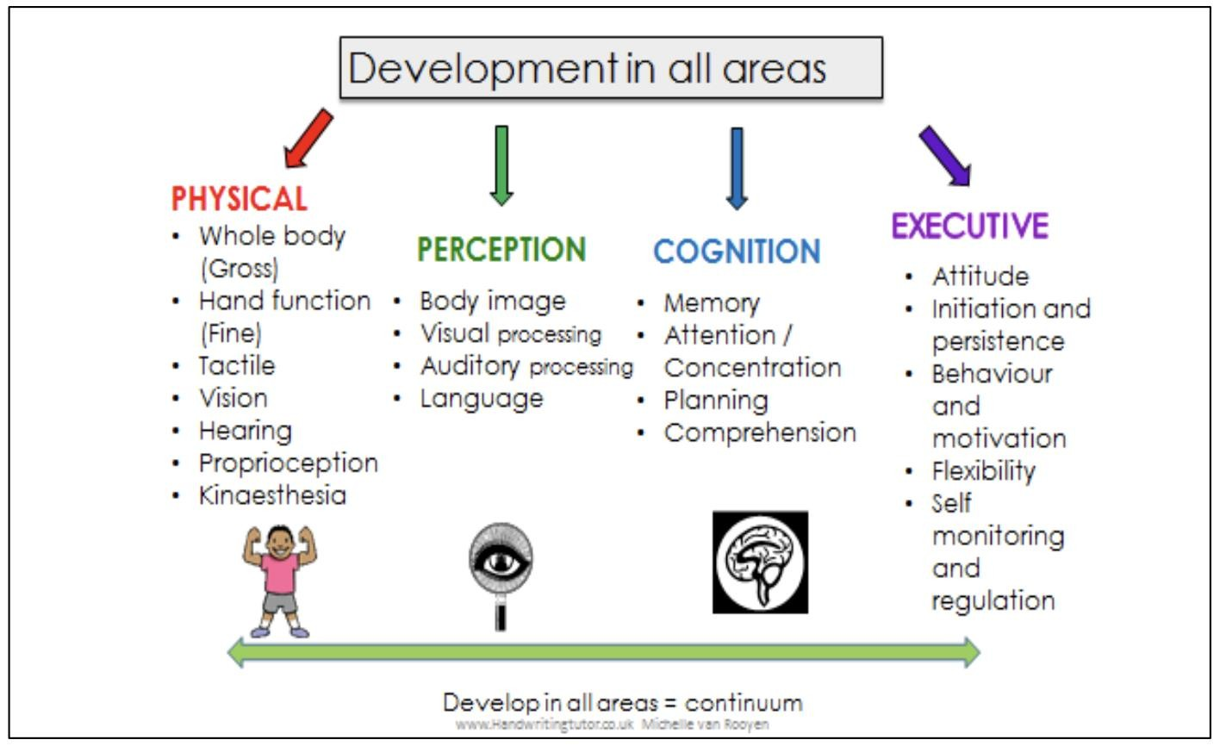
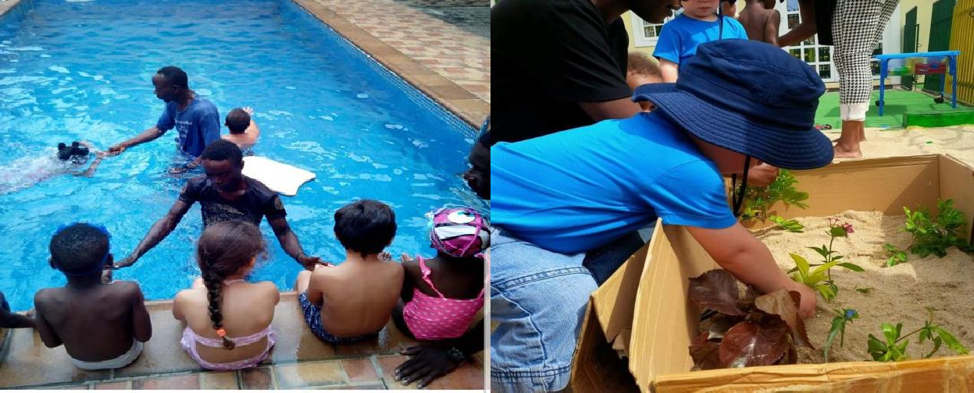
Primary Section
The curriculum at whiteoak guides the teaching and learning from reception class all the way through to year 6.
At Whiteoak School, we make use of the British national curriculum with a blend of the Nigerian curriculum. Our children have exceled over the years beyond their limits because each child is handled uniquely with reference to individual needs. (Developing Foundation and secured).

Slide 13
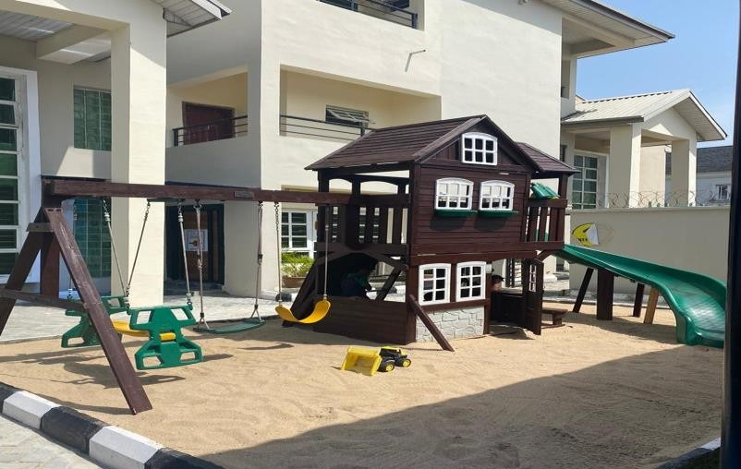
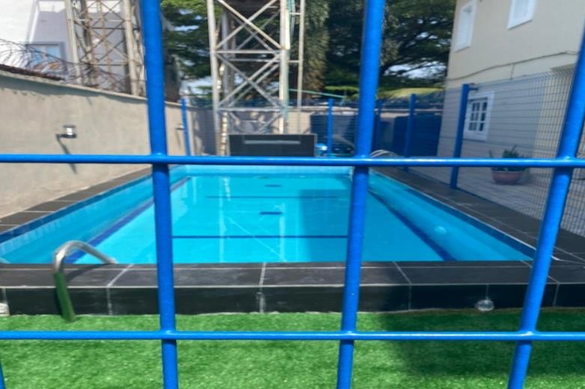
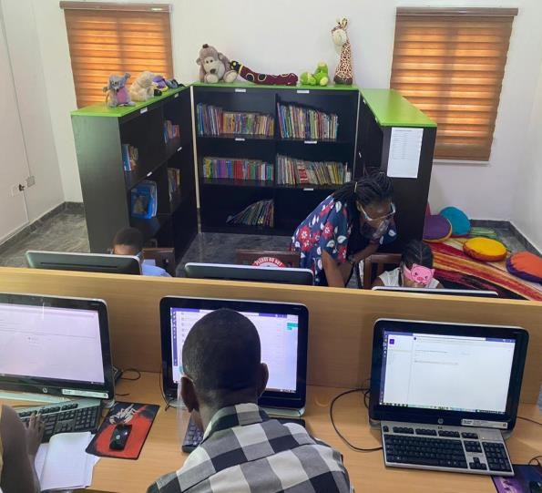
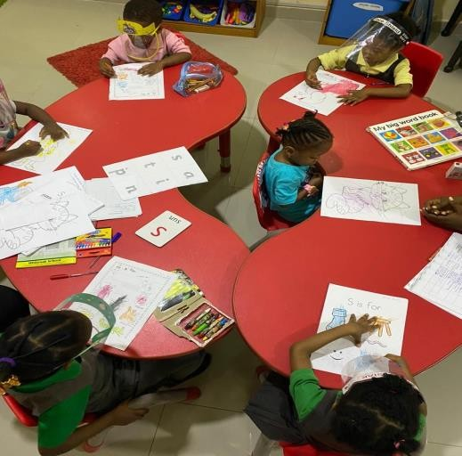
Overview of Some of Our Facilities
Playground
Pool
State of the Art Computer Lab
Spacious Classrooms

Slide 14
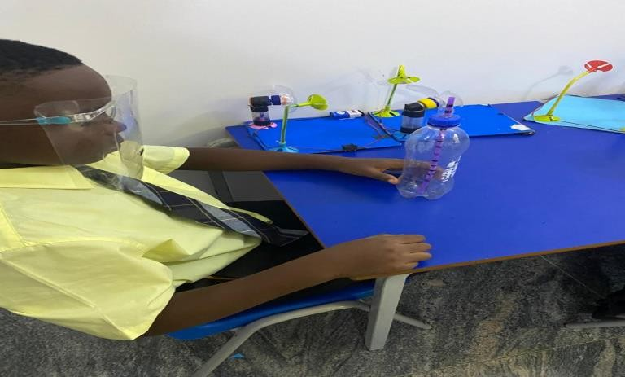
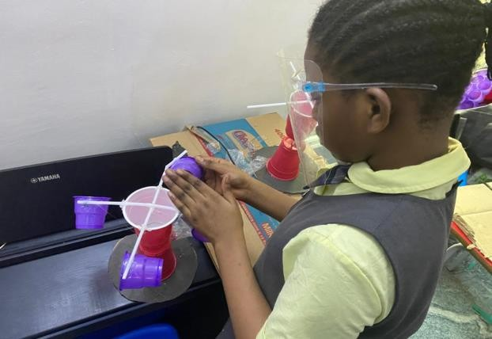
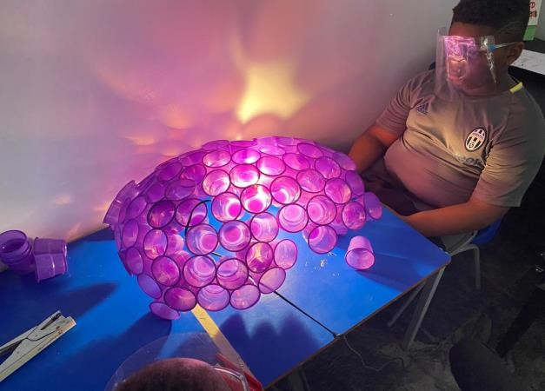
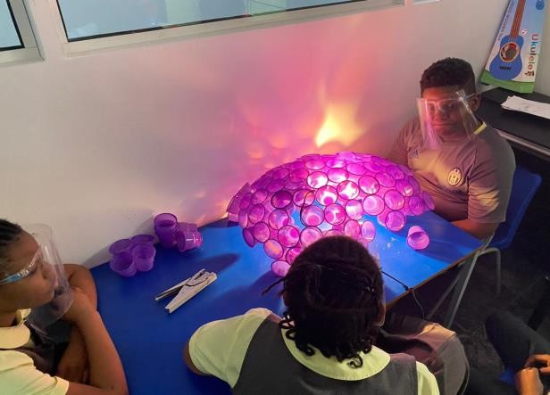
Our Edge
Whiteoak School offers up to date Nigerian and British curriculum to help in the complete development of the child. Coupled with the most contemporary teaching facilities and equipment we ensure every child is well thought. We offer STEAM activities to help sharpen the young minds of our pupils as they grow older.
Steam Activities at Whiteoak School

Slide 15
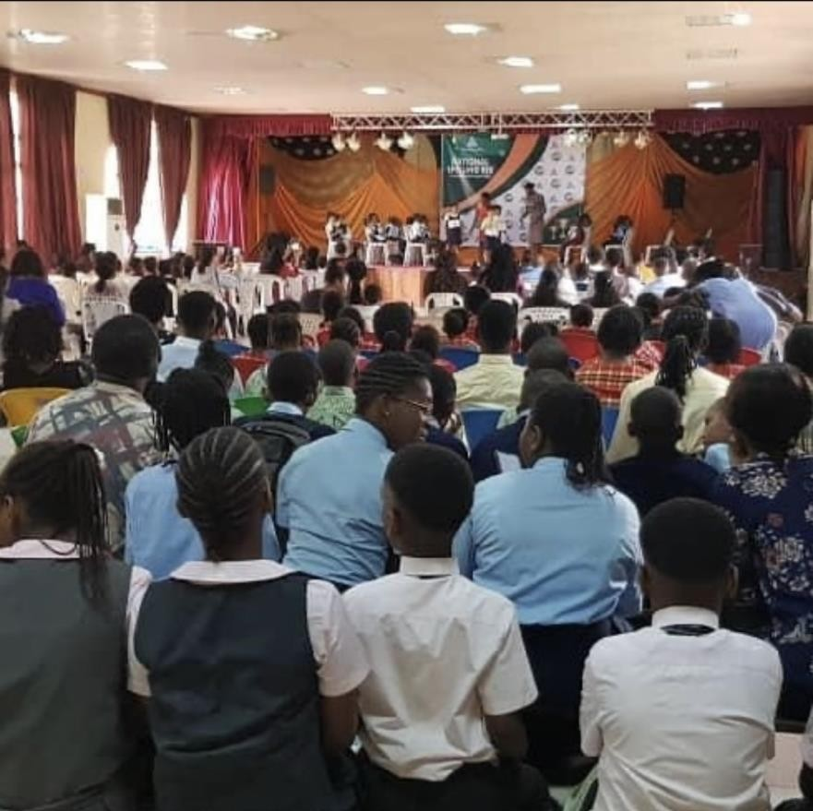
Seminars/Inter School Competition: Seminars helps teaching pupils topics away from their regular scheme of works. These topics supplement the pupils with more knowledge that aid in their growth mentally and spiritually. Inter school competitions also help in giving the school awareness and boosting the confidence of the child as a whole. It also serves as a form of socializing among peers from neighboring schools.
OVERVIEW OF WHITEOAK PUPILS AT THE NATONAL SPELLNG BEE

Slide 16
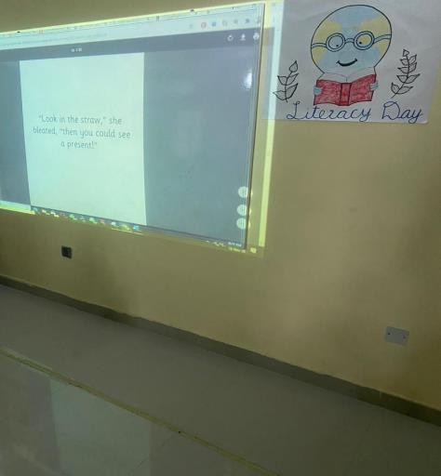
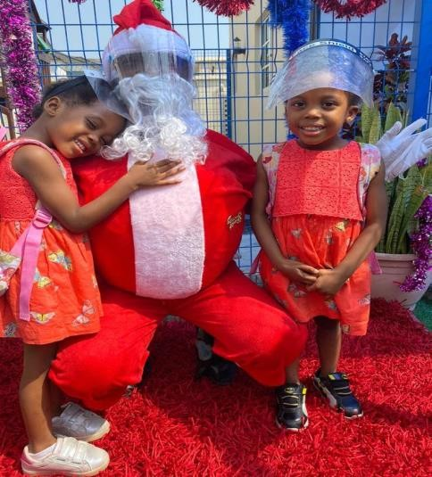
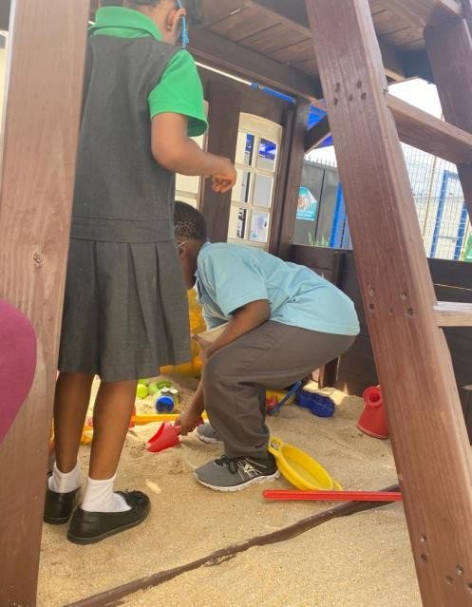
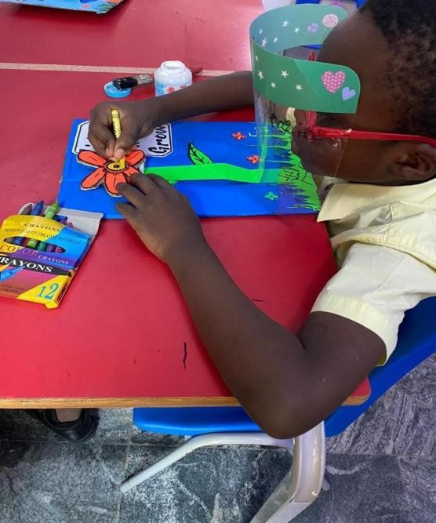
LESSONS ON THE INTERACTIVE BOARD
CHRISTMAS PARTY
EXTRACURRCULAR ACTIVITIES
ARTS AND CRAFT

Slide 17
OUR VALUES
Good manners: I use my magic words….I say please and thank you.
Collaboration: I get along well with others, share and take turns
Morality: I tell the truth,even when I know I might get into trouble.
Tolerance and respect for others: other people are just as important as me and my family.
Respect for property : I look after things in school.
Self control: I behave myself in school.
Compassion: I say and do kind things.
Courage and individuality: I try and persevere with new things and do things for myself
Self image : I look after and respect myself.
We are available from Monday – Friday 7am to 5pm
If you need a tour of the school premises we are available or any questions that need clarification kindly send us a mail or call the office number below.
Email :office@whiteoakschoollagos.com
Instagram : @whiteoakschoollagos
Facebook :whiteoakschoollagos

Slide 18
CONTACT US
Whiteoak School
ADDRESS:
Block 118 plot 15 Jasper Ike Street. (Oniru), Lekki right Phase 1 Lagos,
Nigeria
TELEPHONE : 07046310631 09088760949 09088760949
EMAIL : office@whiteoakschoollagos.com
OFFICE HOURS : 7.00 am - 5.00pm; Monday - Friday

